Slide 1
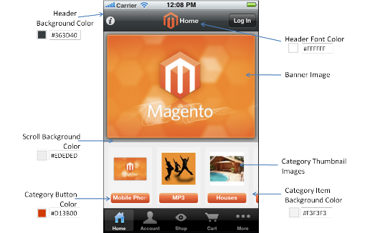














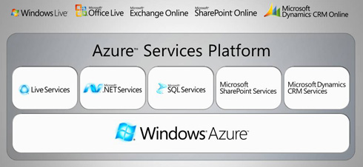


Application
Where are we ?
IDE
Mind Manager for process tracking and Documentation
Design Spec
DEMO
Plan Release
REP MGR
SCM
CI
CONTAINER
TEST
CONFIG
CLOUD
PROVISION
Code commit
SCM
CI/Build
Integration testing
Functional testing
UAT
Deploy to pre-prod
Performance testing
Deploy to production
DEV
QA/Test
PRE-PROD
release alert & details
PRODUCTION
APM

